Slide 1
KOTLIN CONCEPTS

Slide 2
TODAY’S AGENDA
Kotlin Concepts – private constructor, Singleton Objects, Companion Objects
Kotlin scoping functions - let, run, apply, with and also
Classes - Delegation
Strings with Regular expressions

Slide 3
private constructor
used to stop the object creation for the unwanted case; if the user has decided to create the object for themselves accordingly, the memory will be allocated for the specific instance and also the class methods which is used for referring the main method instance the private constructor is also called as the singleton pattern.
The constructor provides the custom visibility in the class header using the constructor parenthesis. The default function will be applied directly to the objects related to the standard libraries on kotlin language.

Slide 4
Pros and cons of Private constructor
The first benefit of using a private constructor is security. Since no other classes can access the data of the private class, it becomes secure.(pros)
Memory efficiency is also an advantage of using private constructors means that only a single instance is created. Moreover, it can also prevent the automatic generation of a default constructor.(pros)
private constructors do not allow inheritance. Additionally, if we want to initialize a private constructor class, we need to use a nested class or a static method.(cons)

Slide 5
syntax for private constructor
class name private constructor(){
--some methods—
}
companion object
{
private var refs : name?=null
fun getInstance(): name{
---some logic codes---
}
}

Slide 6
Object
In Java, the static keyword is used to denote methods and properties that belong to an object, not to an instance of an object.
The static keyword is also used to create Singletons, one of the most widely used design patterns. Singletons help you to create a single instance of an object, which can be accessed and shared by other objects.

Slide 7
Object
Kotlin has a more elegant way to deal with this. You can use a single keyword: object, to implement the Singleton pattern.
What is a Singleton?
Singleton is a design pattern which ensures that a class has only one instance and provides a global point of access to the object. The Singleton pattern is particularly useful for objects which need to be shared between different parts in your app and for resources that are expensive to create.

Slide 8
Kotlin doesn’t have static methods or fields so how can we create a Singleton in Kotlin?
Actually, Android Studio/IntelliJ can help us to understand. When you convert the Singleton code in Java to Kotlin, all static properties and methods are moved to a companion object.
In Kotlin, object is a special class that only has one instance. If you create a class with the object keyword instead of class, the Kotlin compiler makes the constructor private, creates a static reference for the object, and initializes the reference in a static block.

Slide 9
object comes with a limitation. object declarations can not have constructors which means they can not take parameters. Even if they did, it would be impossible to pass a parameter since the non-static parameter passed in the constructor isn’t accessible from the static block.

Slide 10
companion object
companion object is similar to object. companion object is always declared in a class and their properties can be accessed by using the host object. The companion object doesn’t require a name. If the companion object has a name, the caller can access the members using the companion object’s name.
The main use for companion objects is to replace static fields/methods known from Java.

Slide 11
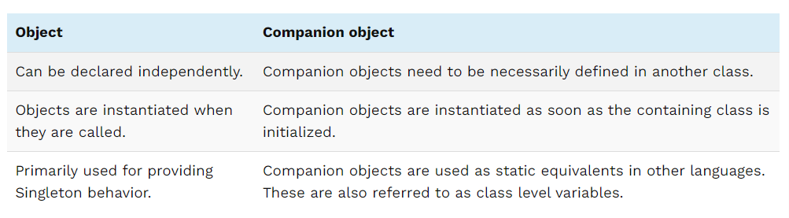
object vs companion object

Slide 12
Scoping functions
In Kotlin, scope functions are used to execute a block of code within the scope of an object. Generally, you can use scope functions to wrap a variable or a set of logic and return an object literal as your result. Therefore, we can access these objects without their names. There are five types of scope functions in Kotlin: let, with, run, apply, and also.

Slide 13
Advantages
Reduced boilerplate code
Enhanced code readability
More concise and precise code
Reduced code repetition

Slide 14
let function
The let function has numerous applications, but it is generally used to prevent a NullPointerException from occurring. The let function returns the lambda result and the context object is the it identifier. Let’s consider the following example:
fun main (){ val name: String? = null println(name!!.reversed) println(name.length) } | fun main (){ val name: String? = null name?.let{ println(it.reversed) println(it.length) } }

Slide 15
with function
The with function has a return type as the lambda result, and the context object is the this keyword, which refers to the object itself.
used to change instance properties without the need to call dot operator over the reference every time.

Slide 16
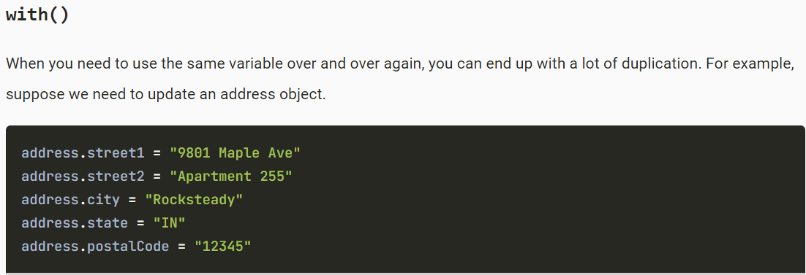
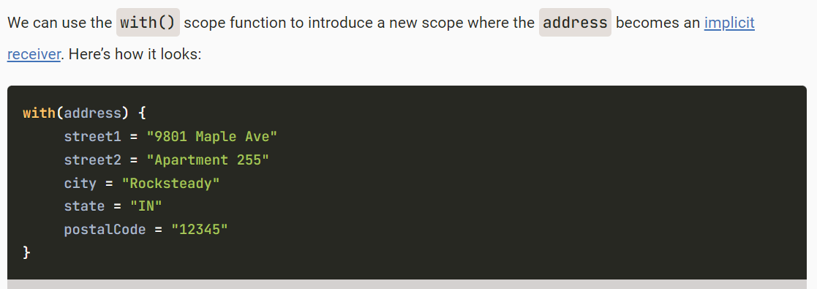

Slide 17
run function
The run function returns the lambda result, and we refer to the context object by using the this keyword.
works like extension fn to an object

Slide 18
apply function
apply executes a block of code on an object and returns the object itself. Inside the block, the object is referenced by this. This function is handy for initializing objects.

Slide 19
also function
also function is used to perform some additional operation on a particular object after we have initialised it.

Slide 20
When and how to use Kotlin scope functions
Using scope functions in the right place might seem a bit tricky at first, but it largely depends on what we want to achieve with project. Let’s refer the summary below as a guide to inform us on which scope function to use for each unique use case:
apply: You want to configure or initialize an object
with: You want to operate on a non-null object
let: You want to execute a lambda function on a nullable object and avoid NullPointException
run: You want to operate on a nullable object, execute a lambda expression, and avoid NullPointerException. This is the combination of the with and let function features
also: You want to perform some additional object operations and configurations

Slide 21
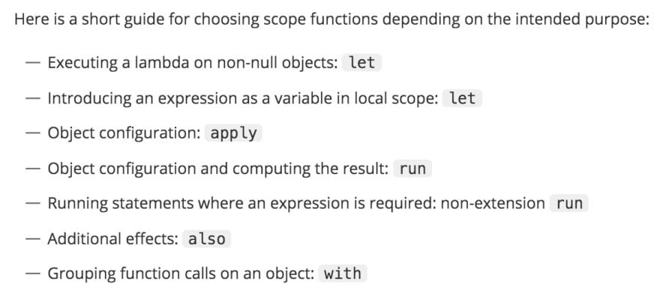
notes on scope fns

Slide 22
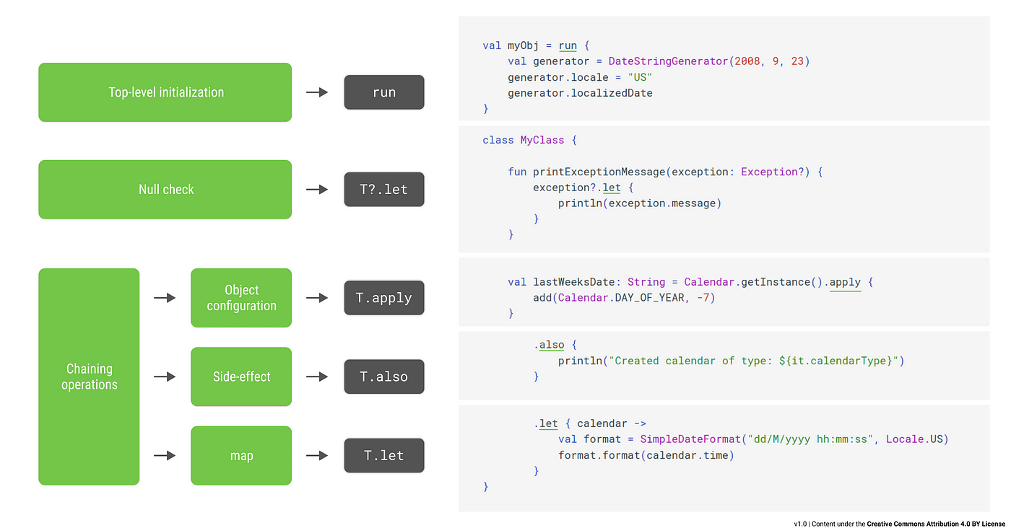
example

Slide 23
class delegation
Kotlin supports “delegation” design pattern by introducing a new keyword “by”. Using this keyword or delegation methodology, Kotlin allows the derived class to access all the implemented public methods of an interface through a specific object.
Delegation means passing the responsibility to another class or method. When a property is already declared in some places, then we should reuse the same code to initialize them.

Slide 24
Kotlin has added a new keyword called "by" to support the "delegation" design pattern. The derived class can access all the implemented public methods of an interface through a particular object using Kotlin's delegation or keyword techniques
Types of Delegation
There are two types of Delegation in Kotlin.
Explicit delegation: This delegation is supported by all object-oriented language, and it is done by providing the delegating object with a delegate object.
Implicit delegation: In this delegation, language-level support for the delegation pattern is necessary.

Slide 25
Using Lazy()
Lazy is a lambda function which takes a property as an input and in return gives an instance of Lazy<T>, where <T> is basically the type of the properties it is using.
Delegetion.Observable()
Observable() takes two arguments to initialize the object and returns the same to the called function.

Slide 26
Storing Properties in a Map
One common use case is keeping property values on a map. This commonly occurs in applications like parsing JSON or carrying out other dynamic operations. Here, the map instance itself can serve as the delegate for a delegated property.

Slide 27
REGEX
In Kotlin, we build regular expressions with the Regex.
Regex("book")
"book".toRegex()
Regex.fromLiteral("book")
A pattern is a regular expression that defines the text we are searching for or manipulating. It consists of text literals and metacharacters. Metacharacters are special characters that control how the regular expression is going to be evaluated. For instance, with \s we search for white spaces.

Slide 28
Special characters must be double escaped or we can use Kotlin raw strings.
After we have created a pattern, we can use one of the functions to apply the pattern on a text string. The funcions include matches, containsMatchIn, find, findall, replace, and split.

Slide 29
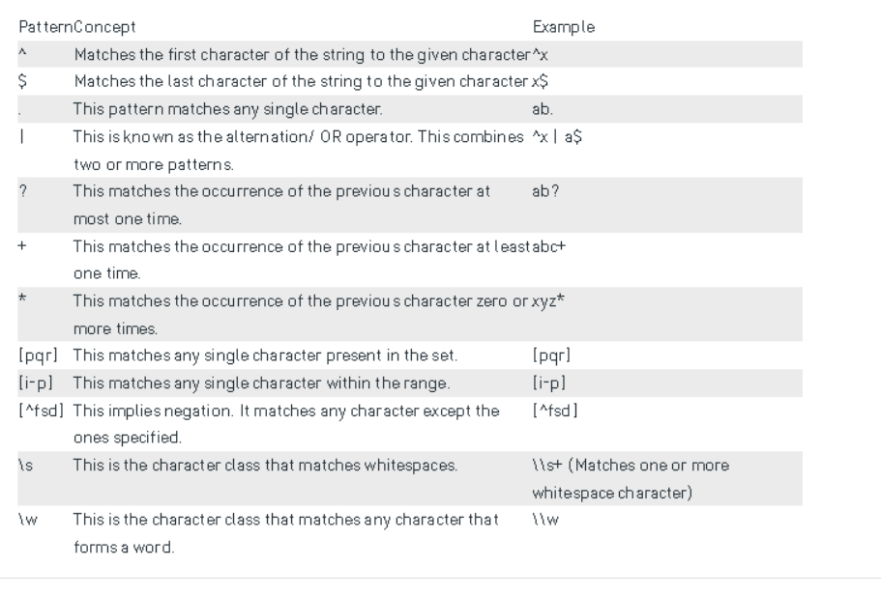

Slide 30
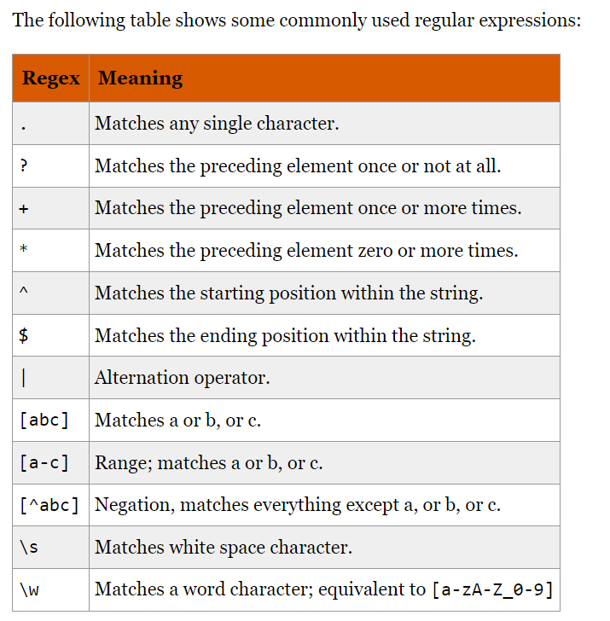

Slide 31
matches and containsMatchIn methods
The matches method returns true if the regular expression matches the entire input string. The containsMatchIn method indicates whether the regular expression can find at least one match in the specified input.

Slide 32
find method
The find method returns the first match of a regular expression in the input, beginning at the specified start index. The start index is 0 by default.

